Slide 1
Soft matter, colloids and self-assembly to create mesoporous materials
February 24, 2020

Slide 2
Soft /Condensed Matter
The phrase “soft matter” was used by Pierre de Gennes as the title of his 1991 Nobel Prize acceptance speech.
Refers to condensed matter that exhibits characteristics of both solids and liquids
Soft matter can flow like liquids (measurable viscosity)
Soft matter can bear stress (elastic deformation)
Viscoelastic behaviour = viscous + elastic
Examples: rubbers, gels, pastes, creams, paints, soaps, liquid crystals, proteins, cells

Slide 3
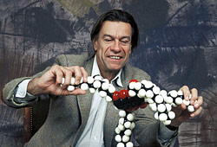
Soft Matter
Soft matter does not exhibit the crystalline order that is characteristic of most hard matter (except amorphous solids).
Nevertheless, some order remains. Soft matter lends itself to self-assembly which produces a large variety of nanostructures.
Pierre-Gilles de Gennes received the 1991 Physics Nobel Prize for bringing order into soft matter, particularly liquid crystals and polymers.

Slide 4
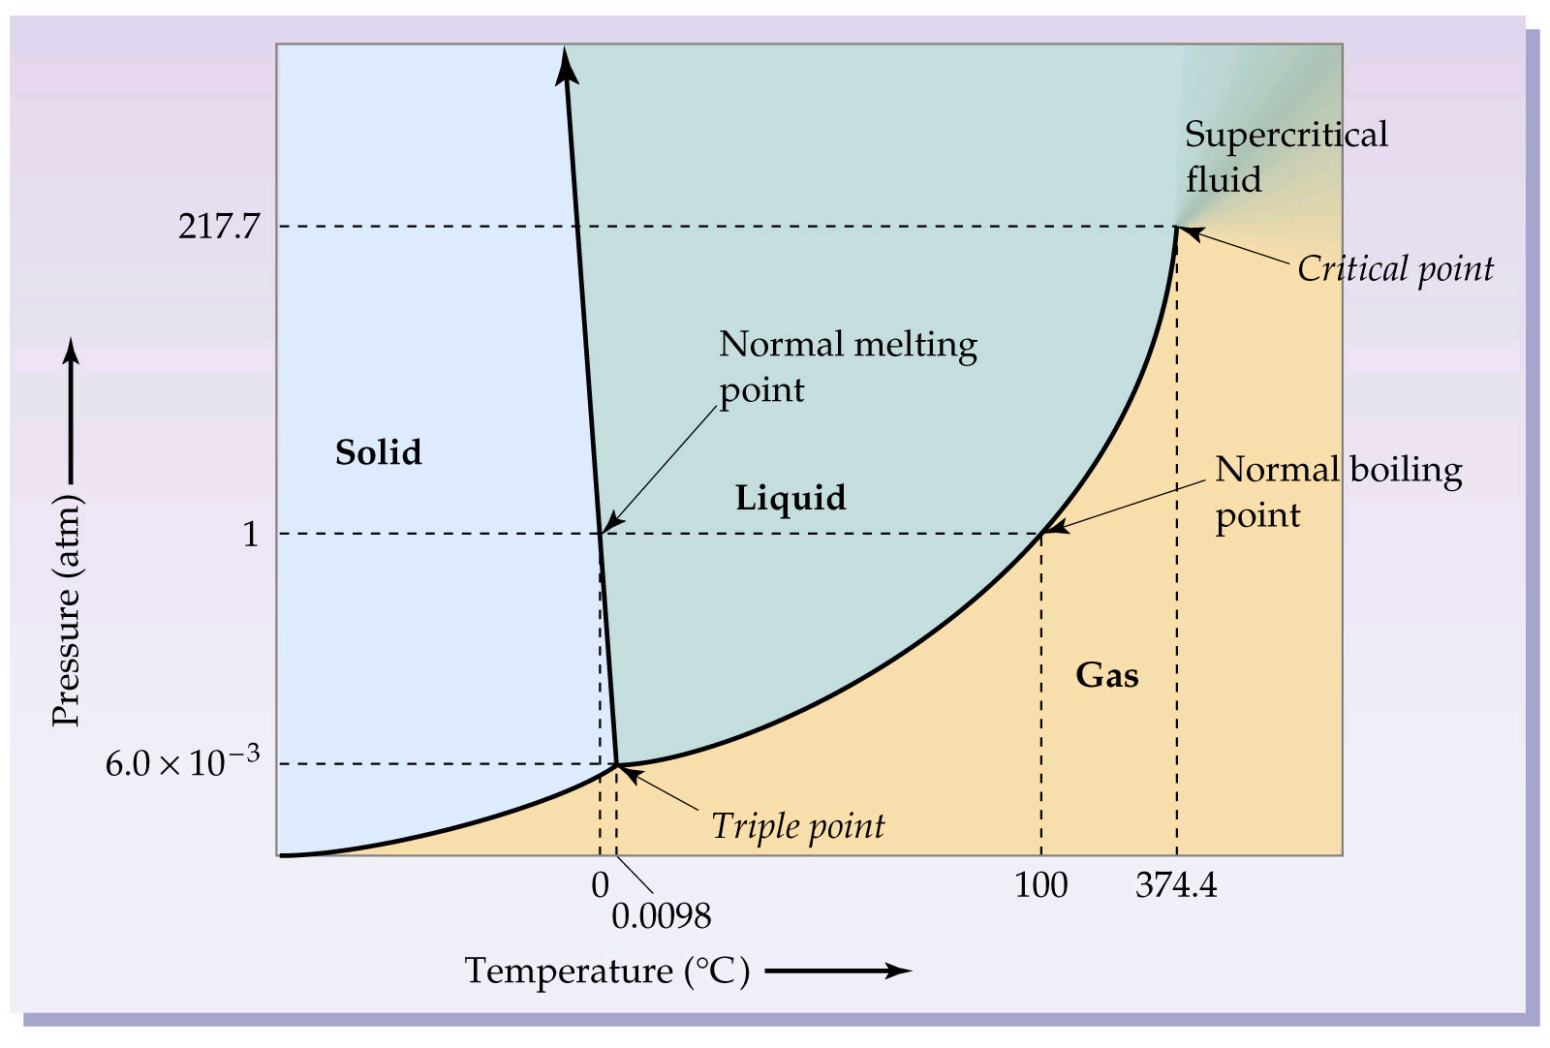
Phase diagram of water
Image: http://wps.prenhall.com/wps/media/objects/602/616516/Chapter_10.html

Slide 5
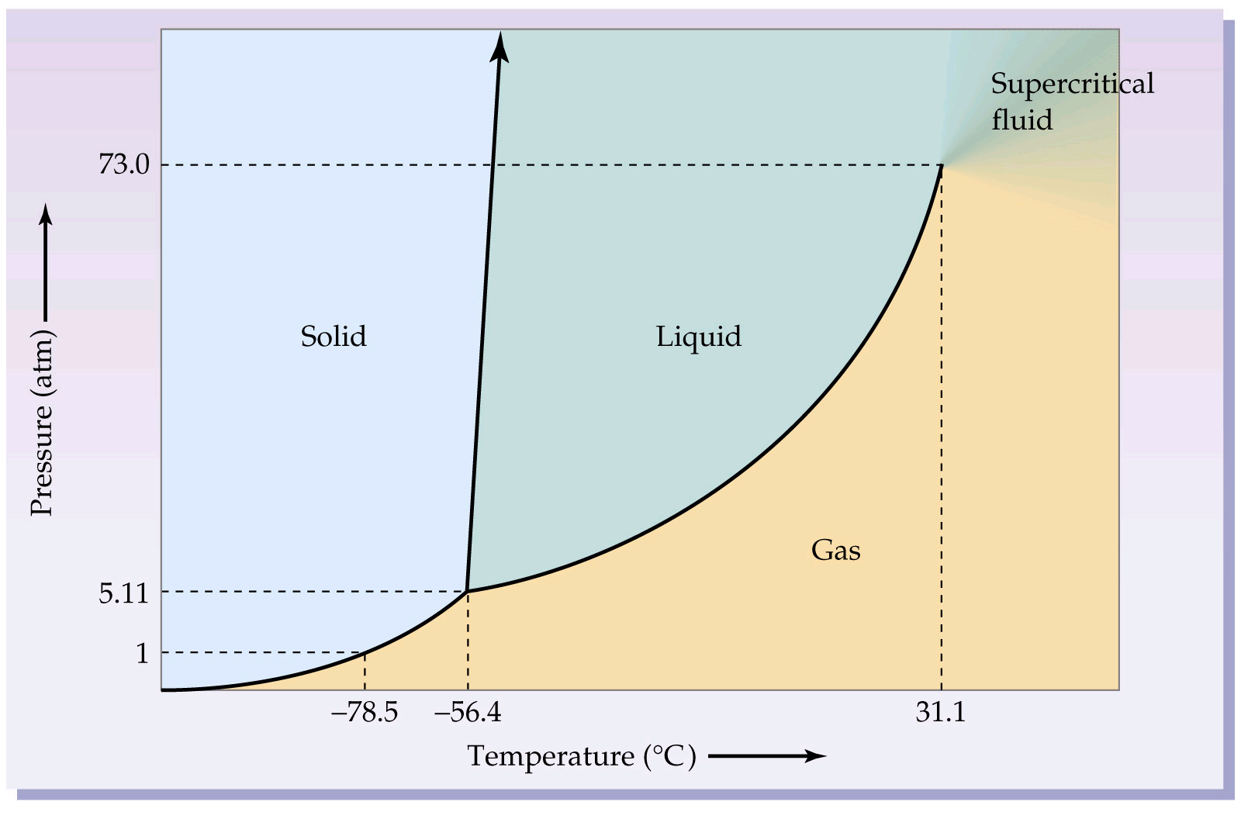
What is Condensed Matter?
“Condensed matter” refers to matter that is not in the gas phase but is condensed as a liquid or solid. (condensed ➔denser!)
Matter condenses when attractive intermolecular bond energies are comparable to or greater than thermal (i.e. kinetic) energy ~ kT.
Phase diagram of carbon dioxide
Image: http://wps.prenhall.com/wps/media/objects/602/616516/Chapter_10.html

Slide 6
Soft matter
Colloids
Types
Polymers
Liquid Crystals

Slide 7
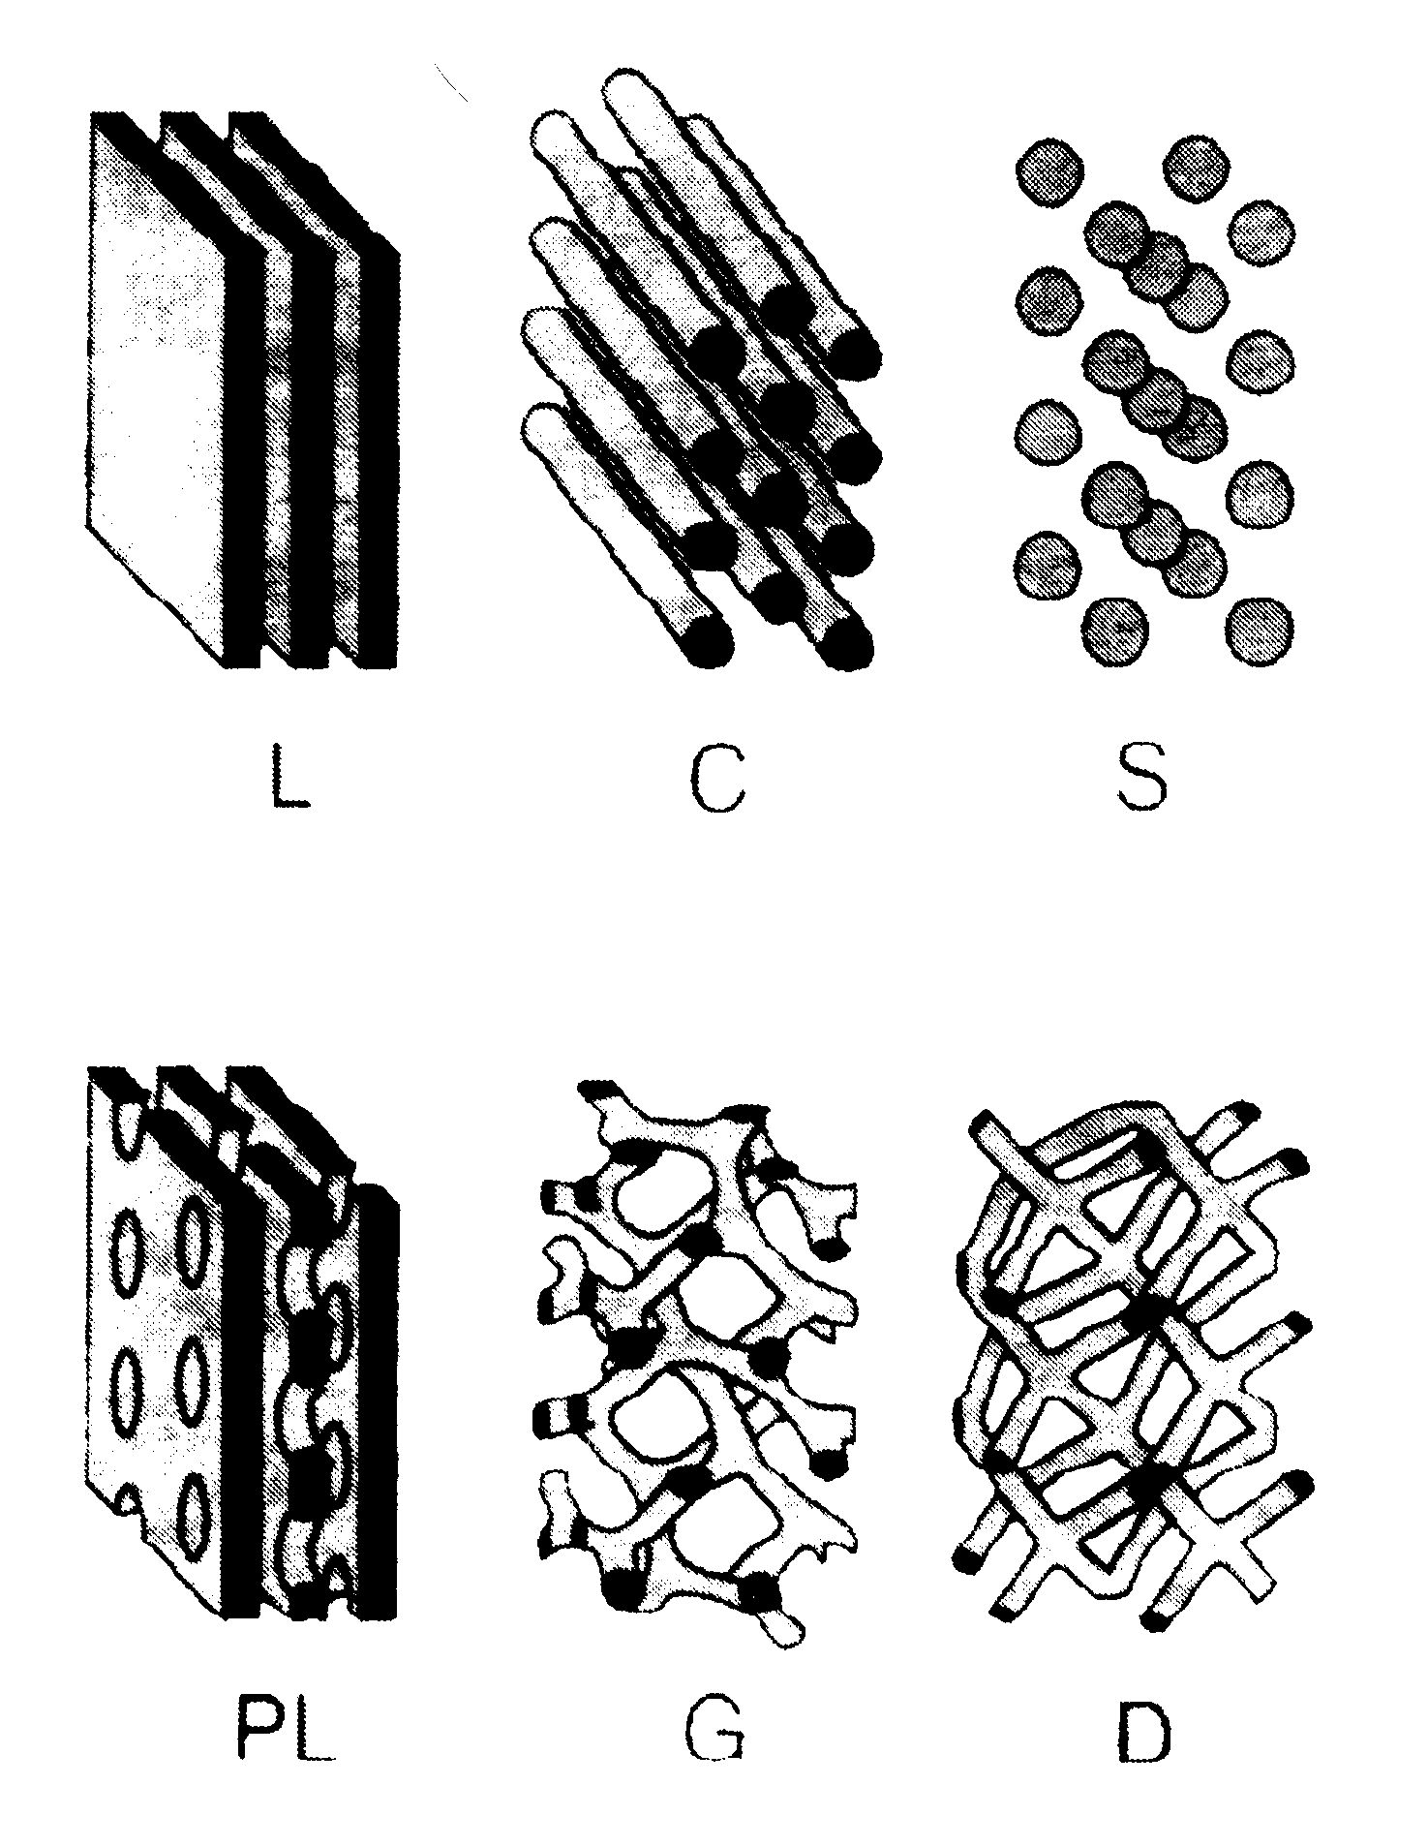
Four characteristics of Soft Matter
Length scales
- Structures of ≈10-1000 nm determine the properties
Time scales: processes from 10⁻¹² - 10³ s
- Dynamics processes over a wide time scales 10⁻¹² - 10³ s
- Very slow processes in non-equilibrium configurations
Weak interactions
- Interactions between molecules and molecular structures ≈ kT
Self assembly
- Hierarchical arrangement of structures
- Competition between interaction energy and entropy

Slide 8
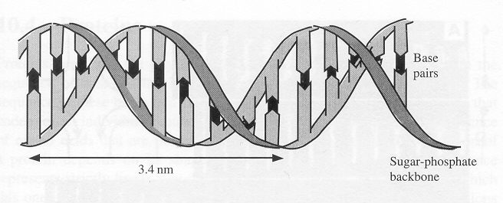
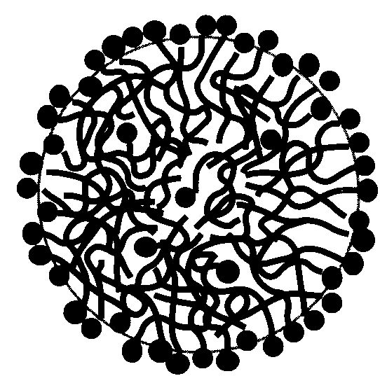
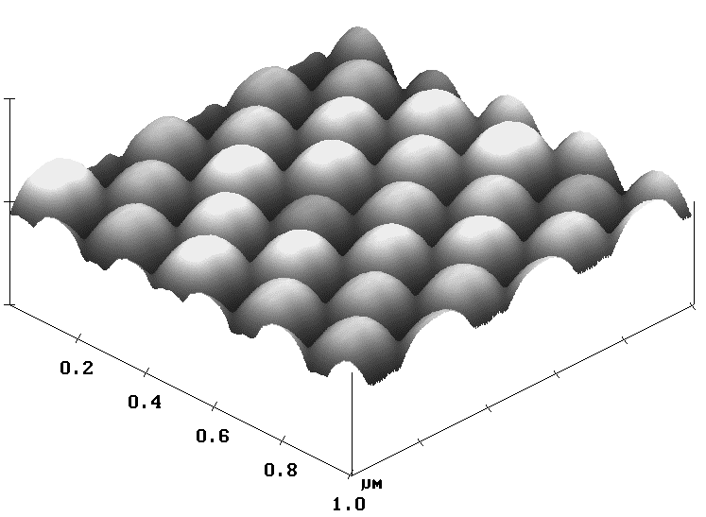
Typical Length Scales
Atomic spacing: ~ 0.1 nm = 1A⁰
“Pitch” of a DNA molecule: 3.4 nm
Diameter of a surfactant micelle: ~6-7 nm
Gyration radius of a polymer molecule: ~10 nm
Diam. of a colloidal particle (e.g. in paint): ~200 nm
Bacteria cell: ~2 μm
Diameter of a human hair: ~80 μm

Slide 9
Thermal fluctuations
V_{z}
V
V_{y}
The kinetic energy for a particle of mass, m, is 1/2 mv² = 3/2 kT. When m is small, v becomes significant.
V_{x}
Soft condensed matter is not static but in constant motion at the level of molecules and particles.
The “equipartition of energy” means that for each degree of freedom of a particle to move, there is 1/2kT of thermal energy.
For a colloidal particle able to undergo translation in the x, y and z directions, thermal energy is 3/2 kT.
k = 1.38 x 10⁻²³ JK⁻¹, so kT = 4 x 10⁻²¹ J per molecule at room temperature (300 K).
kT is a useful “gauge” of bond energy.

Slide 10
Thermal fluctuations of Soft Matter
The importance of thermal fluctuations and Brownian motion
https://www.youtube.com/watch?v=PzssJDZn9xI
Brownian motion can be though of as resulting from a slight imbalance of momentum being transferred between liquid molecules and a colloidal particle.

Slide 11
Colloids

Slide 12
Colloids
A colloid has sub-μm particles (but not single molecules) of one phase dispersed in a continuous phase.
The size scale of the dispersed phase is between 1 nm and 1 μm.
The dispersed phase and the continuous phase can consist of either a solid (S), liquid (L), or gas (G)
Dispersed Phase | Continuous Phase | Name | Example
L/S | G | aerosol | Fog, hair spray, smoke
G | L/S | foam | Beer froth, shaving foam
L | L/S | emulsion | Mayonnaise, salad dressing
S | L | sol | Latex paint, tooth paste
S | S | solid suspension | Pearl, mineral rocks
There is no “gas-in-gas” colloid, because there is no interfacial tension between gases!

Slide 13
Interfacial Area of Colloids
For a spherical particle, the ratio of surface area (A) to volume (V) is:
r
Thus, with smaller particles, the interface becomes more significant. A greater fraction of molecules is near the surface.
Consider a 1 cm³ phase dispersed in a continuous medium:
No. particles Particle volume(m³) Edge length (m) Total surface area(m²)
1 10⁻⁶ 10⁻² 0.0006
10³ 10⁻⁹ 10⁻³ 0.006
10⁶ 10⁻¹² 10⁻⁴ 0.06
10⁹ 10⁻¹⁵ 10⁻⁵ 0.6
10¹² 10⁻¹⁸ 10⁻⁶ 6.0
10¹⁵ 10⁻²¹ 10⁻⁷ 60
10¹⁸ 10⁻²⁴ 10⁻⁸ 600

Slide 14
Mesoporous Materials

Slide 15
Outline
What are they?
What are they useful for?
What are some of the theoretical aspects behind these materials?
How can we synthetize them?
What are the factors affecting their sizes, shapes and their existence ?

Slide 16
What are mesoporous materials?
Porous materials whose pores are between 2 and 50 nm in diameter.
The mesoporous materials investigated here have uniformly ordered pores.
Silica based materials first synthesized by scientists at the Mobil Corporation in 1992.
Non-silica mesoporous materials first reported at UC Santa Barbara in 1994.

Slide 17
Applications
Molecular sieves
High surface area catalysts
Gas sensors
Dye sensitized photovoltaic solar cells
0-Dimension nano-particles

Slide 18

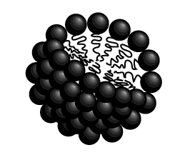
Mesoporous materials are templated by amphiphilic molecules.
An amphiphillic molecule has a hydrophillic (water loving) head and a hydrophobic (water loathing) tail.
Surfactant is an amphiphilic molecule with a tendency to adsorb onto free surfaces and interfaces and to aggregate to form micelles
A micelle is an association of amphiphillic molecules.
Mesoporous structures are created by the ordered packing of micelles.
Small molecules M_{w}≈100-1000
Courtesy of Brian Eggiman

Slide 19
Why do amphiphiles form micelles?
Gibb’s Free Energy (ΔG) is a thermodynamic quantity which predicts the spontaneity of a reaction. (A decrease in Gibb’s Free Energy indicates a spontaneous reaction)
Water molecules create structure by forming hydrogen bonds with one another.
The hydrophobic tails of individual amphiphiles placed in solution force water molecules to associate in a particular way. This decreases the entropy (ΔS) of the system.
When the hydrophobic tails associate to each other (form micelles) in order to minimize their interaction with water molecules they increase the entropy of the system.
ΔG = ΔH - TΔS
An increase in entropy, decreases Gibb’s Free Energy of the system therefore the reaction will occur spontaneously.

Slide 20
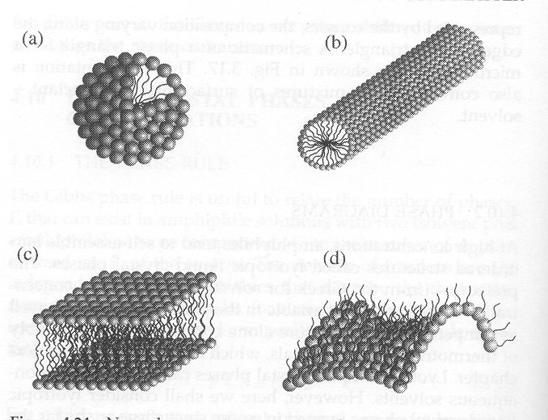
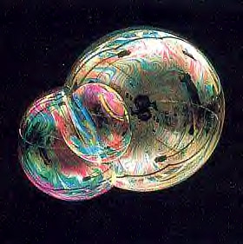
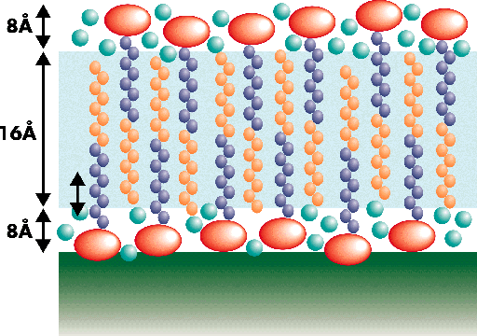
Examples of Self-Assembly
(a)
(b)
(c)
(d)
From I.W. Hamley, Introduction to Soft Matter
Surfactants can assemble into (a) spherical micelles, (b) cylindrical micelles, (c) bi-layers (membranes), or (d) saddle surfaces in bicontinuous structures

Slide 21
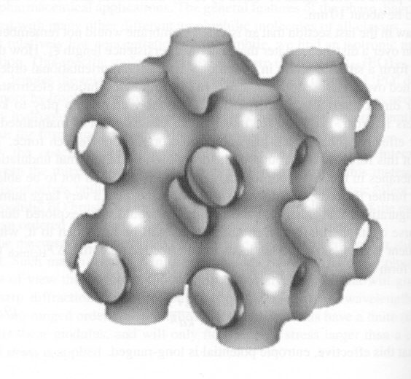
Examples of Self-Assembly
The “plumber’s nightmare”
From RAL Jones, Soft Condensed Matter
Surfactants can create a bi-continuous surface to separate an oil phase and a water phase.
The hydrophilic end of the molecule orients itself towards the aqueous phase.
The oil and water are completely separated but both are CONTINUOUS across the system.

Slide 22
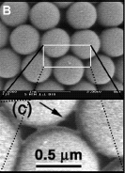
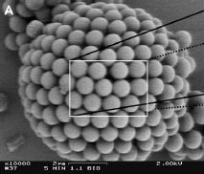
Colloidosomes: Self-assembled colloidal particles
Colloidal particles (<1 μm)
Liquid B
Liquid A
A.D. Dinsmore et al., “Colloidosomes: Selectively Permeable Capsules Composed of Colloidal Particles,” Science, 298 (2002) p. 1006.

Slide 23
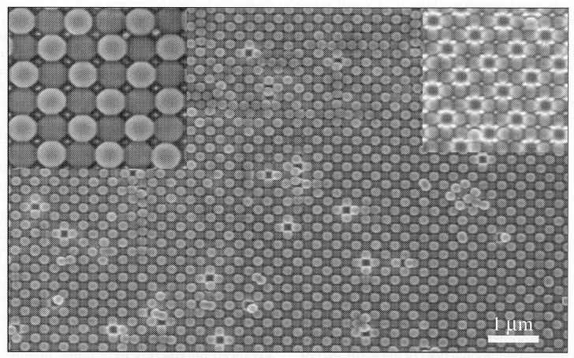
Colloidal Crystals
MRS Bulletin,
Feb 2004, p. 86
Colloidal particles can have a +ve or -ve charge.
In direct analogy to salt crystals of +ve and -ve ions, charge attractions can lead to close-packing in ordered arrays.

Slide 24
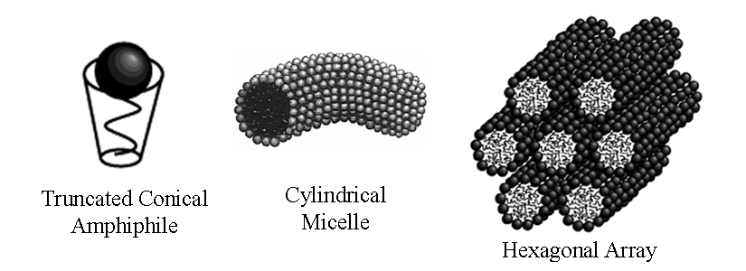
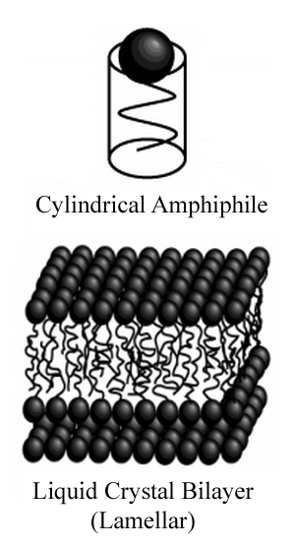
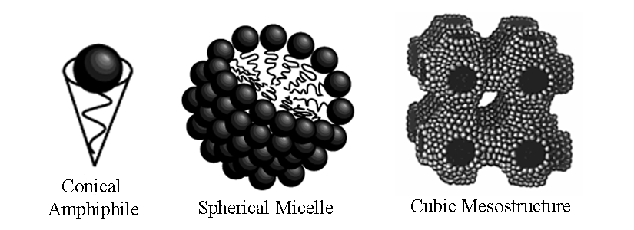
What determines micelle shape?
Diagrams compiled from work by Brian Eggiman and Soler-Illia et al, “Chemical Strategies To Design Textured Materials: from Microporous and Mesoporous Oxides to Nanonetworks and Hierarchical Structures”, Chem. Rev. 2002, 102, 4093-4138.

Slide 25
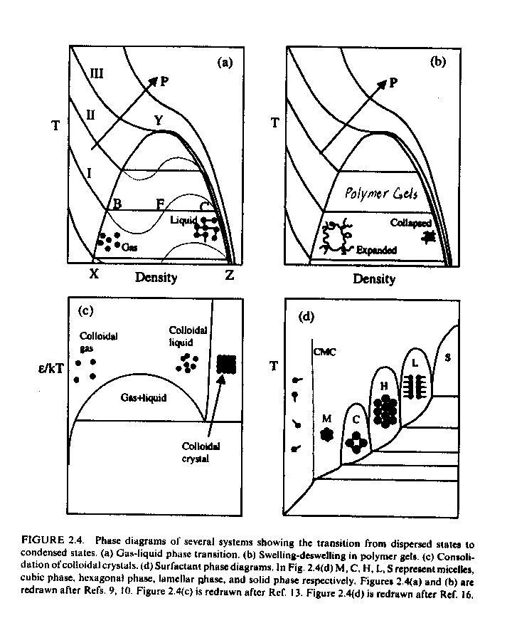
Transition from dispersed state to condensed state: a universal phenomenon Beginning of self-assembly of molecules, polymers, or microscopic particles
Gas (dispersed) → Liquid (condensed)
under van der Waals attraction forces
(b) Polymer gels (dispersed) → Collapsed polymer gel (condensed)
under rubber elasticity (entropy change), counter ions osmotic pressure, and electrostatic repulsive forces
(c) Colloidal particles (dispersed) → self-assembled colloidal crystals and super lattice structures

Slide 26
Surfactants and Amphiphilic Molecules
Surfactant characteristics: Head group charge, chain length, head group size
Cationic:
long chain amines or ammonium salts are positively charges at pH<7,
not charged at pH >7, then not active
quaternary ammonium salts are charged and active at all pH’s
Anionic:
Long chain carboxylic or sulfonic acids, are negatively charges at pH > 7,
(at pH < 7 not ionized, not active)
Surfactant Activity depends on:
pH, ionic strength of the solution and by counter ions
Counter ions neutralize charges on surfactant head groups, and even cause its precipitation.
Non-ionic surfactants have the advantage in that pH, counter ions, or solvents do not affect their activity.

Slide 27
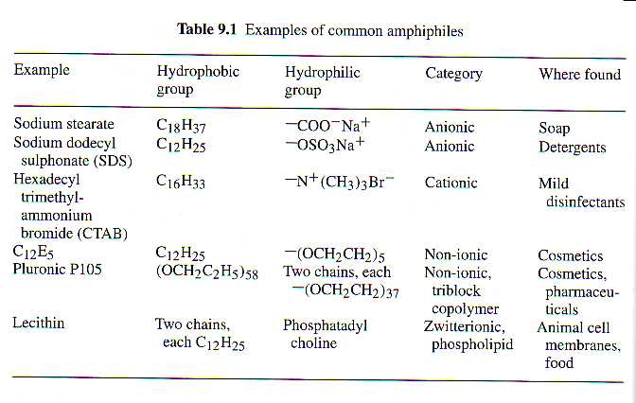
Surfactants and amphiphiles
Amphiphilic molecule: two parts with very different affinities
Ex: hydrophilic head and hydrophobic tail

Slide 28
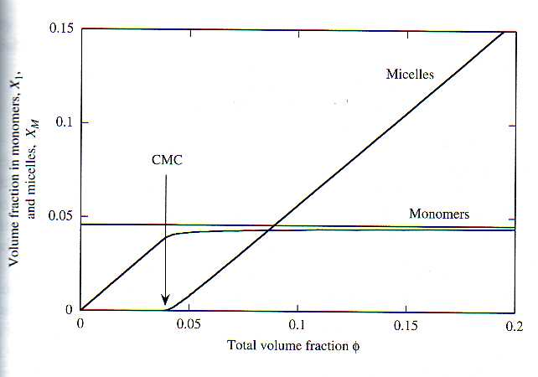
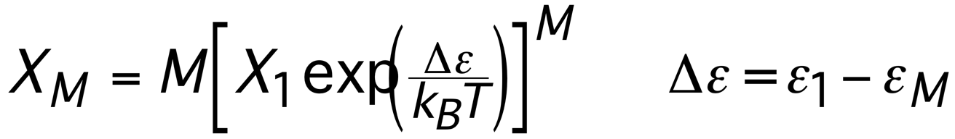
Critical Micelle Concentration
φ - volume fraction of amphiphile
< φ_{c} – monomers
φ > φ_{c} - micelles of average size M
φ_{c} = exp(-∆ε/k_{B}T) (CMC)

Slide 29
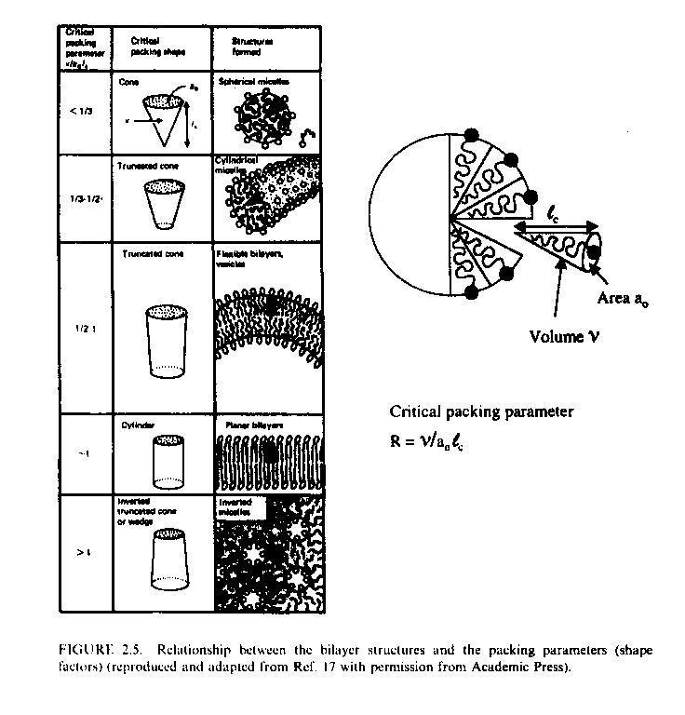
Packing Geometry: Attaining the Desired Self-Assembled Structures
Structure depends on pH, T, electrolyte concentration
Major driving forces for amphiphyles to form well-defined aggregates are:
hydrophobic attraction at hydrocarbon-water interfaces and
hydrophilic ionic or steric repulsion between head groups.
Geometric packing parameter
(shape factor)
v = hydrocarbon chain volume
a₀ = optimal head group area
l_{c} = critical chain length
> 1 | > 0.5 | < 0.5 | R
inverse micelle | bilayers | spherical-cylindrical | structure

Slide 30
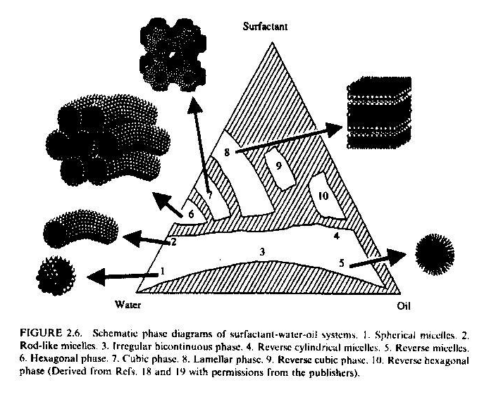
Packing Geometry: Attaining the Desired Self-Assembled Structures at Constant Temperature
Cubic Phase
Lamellar Phase
Hexagonal Phase
Rod-like Micelles
Reverse Micelles
Spherical Micelles
Increase Surfactant Conc.: spherical micelles→ rod-like micelles → cubic → lamellar

Slide 31
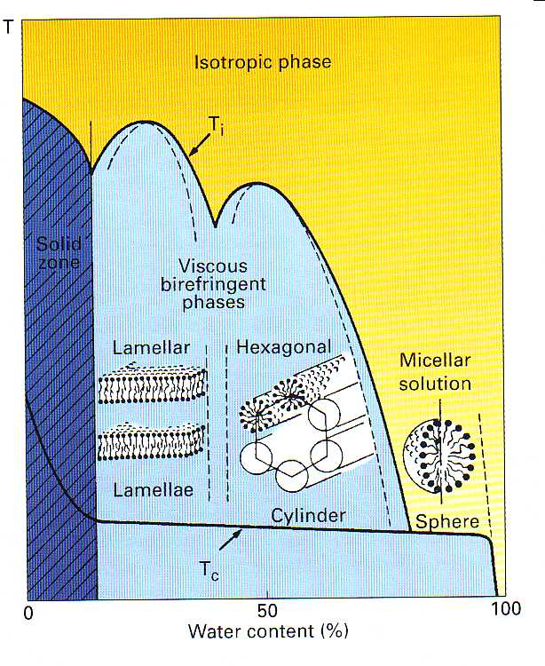
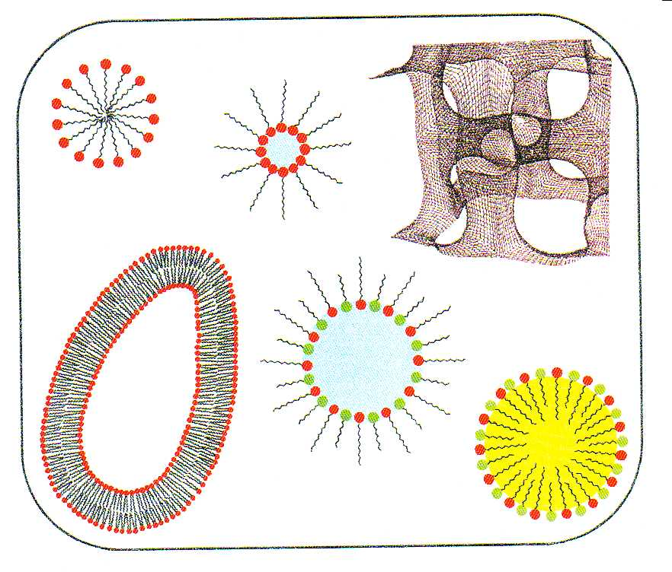
Packing Geometry: Attaining the Desired Self-Assembled Structures vs. Temperature
T

Slide 32
Packing Geometry: Attaining the Desired Self-Assembled Structures considering Physico-Chemical aspects
Effect of surfactant concentration
Surfactant conc ↑: lower hydration of head groups →
lower a₀ → higher R → lamellar structure
Effect of surfactant chain length
If l_{c} increases, v increases, however if R increases too much, spherical → lamellar
Effect of co-solvent
Polar solvents, like alcohols, tend to associate with head groups and reduce the tendency for the surfactant molecules to associate; CM may disappear,
Non-polar solvents associate with hydrophobic chains of the surfactant increase v → increase R → less curved structures
Effect of salts and ionic species
On ionic surfactants, reduces repulsive energy between head groups, reducing a₀ → larger R → less curved structures

Slide 33
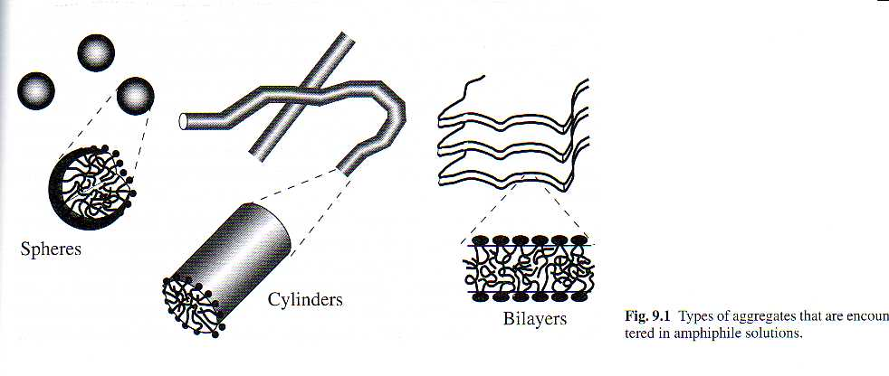
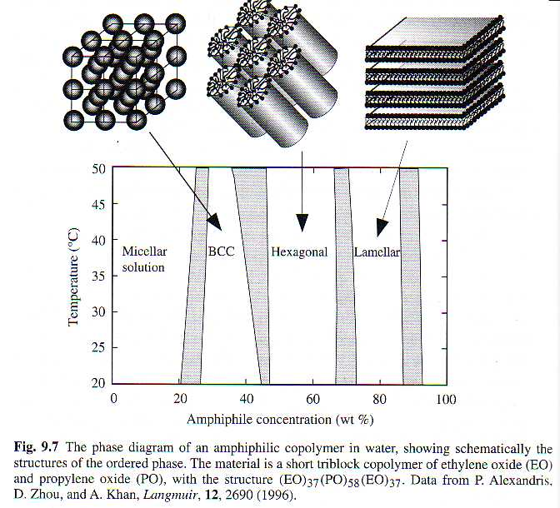
Shape of aggregates
Self assembled structures are rich in phases:
response by changing size and shape and arrangement of micelles
dramatic change in properties
Basic shapes:
spheres
cylinders
bilayers
vesicles
Superstructures:
micellar crystals
lamellar phases
bicontinuous networks
- …

Slide 34
Shape of aggregates
Factors determining the shape
Optimum head group are, a₀
Critical chain length, l_{c}
Hydrocarbon volume, v
l_{c} - length of fully extended tail
v - volume of the tail
# of tails, side groups, …
v
l_{c}

Slide 35
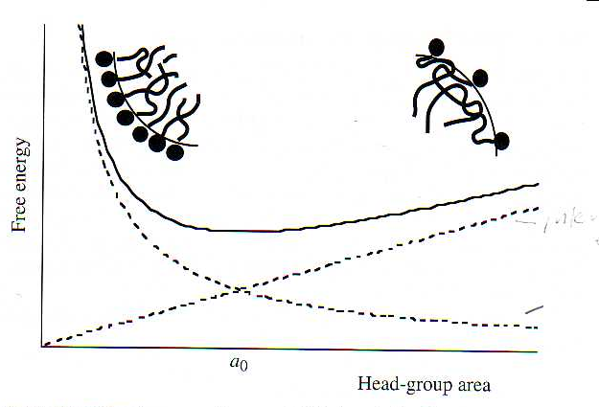
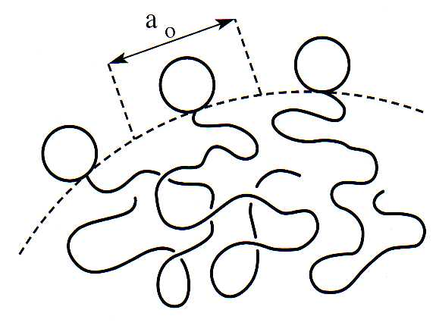
Optimum head group area, a₀
a₀ controlled by
repulsive forces:
electrostatic or steric repulsion
(can be altered by e.g
salt concentration)
attractive forces:
protecting the tail

Slide 36
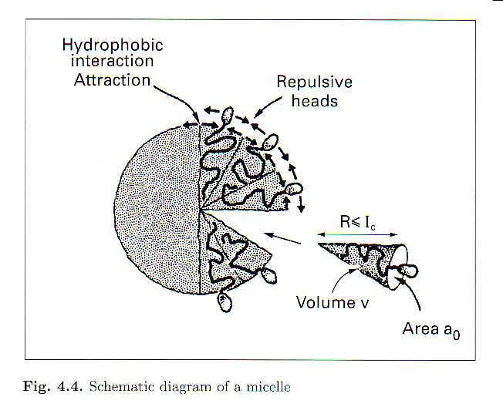
Shape of aggregates
Spheres - smallest area/volume
Volume:
4π r³/3=Nv
(N is the # of molecules in aggregate)
Surface area:
4π r²=Na₀
-> r = 3v/a₀
but r_{max} ≤l_{c}
v/l_{c}a₀ ≤ 1/3 for spherical micells

Slide 37
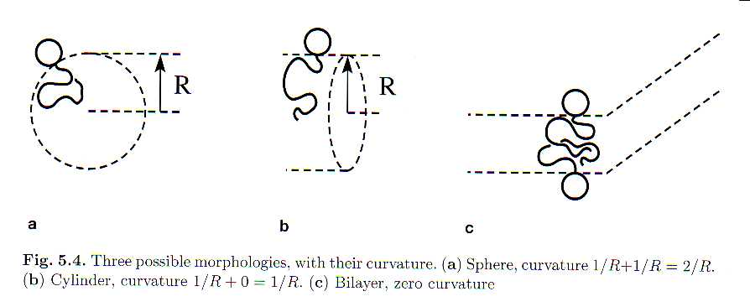
Shape of aggregates
Spheres:
v/l_{c}a₀ ≤ 1/3
Cylinders:
1/3≤ v/l_{c}a₀ ≤ 1/2
Bilayer:
v/l_{c}a₀ > 1/2

Slide 38
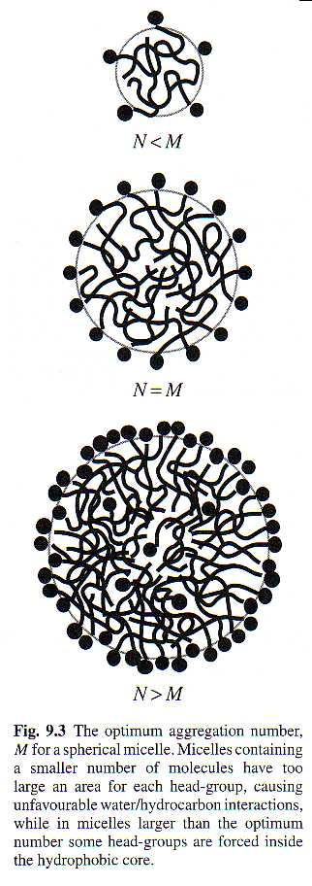
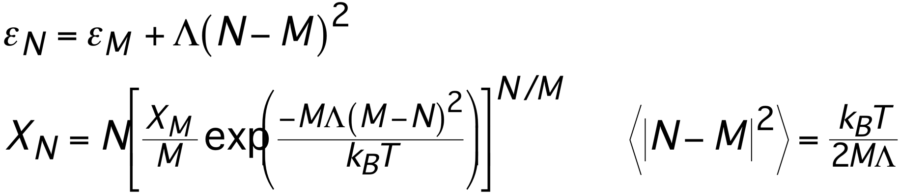
Spherical micelles
Spheres formed when:
v/l_{c}a₀ ≤ 1/3
Size of micelles finite ->
ε_{N} has a minimum value at an optimum number M
X_{N} - volume fraction of micelles
with N molecules
size distribution

Slide 39
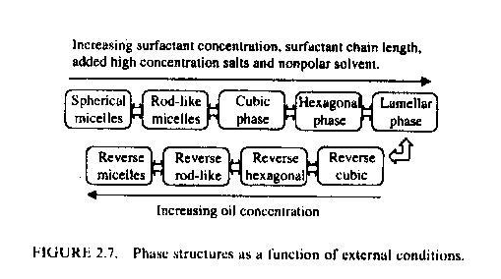
Packing Geometry: Attaining the Desired Self-Assembled Structures

Slide 40
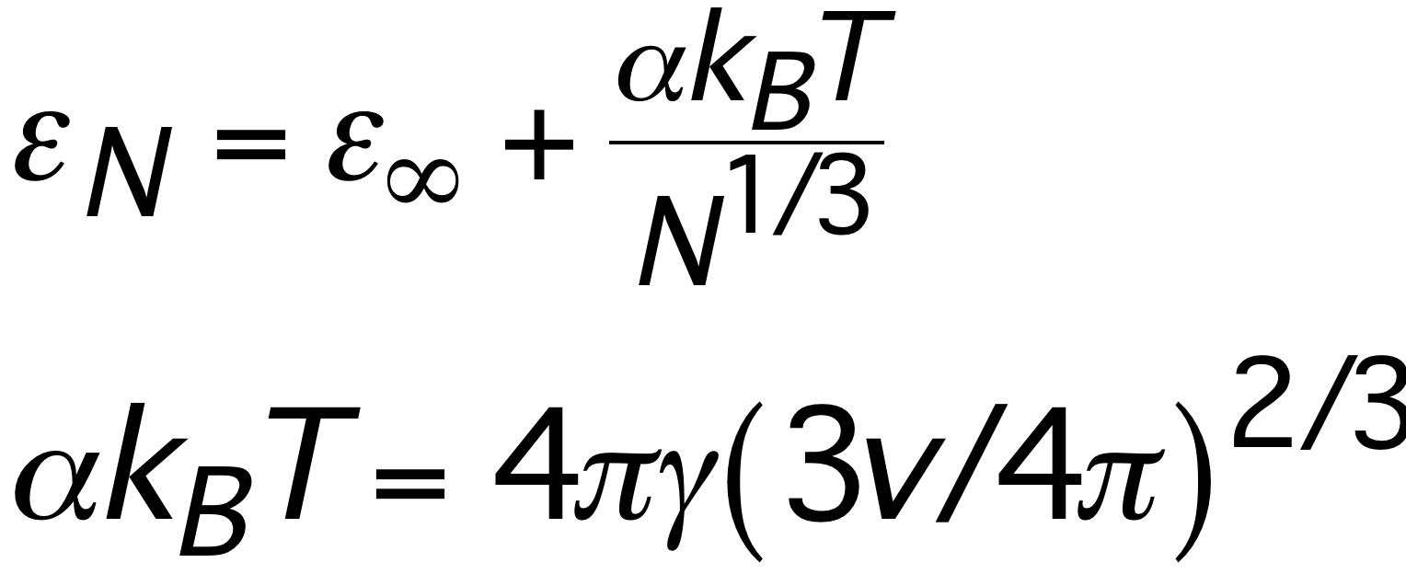
Macro vs. micro phase separation
Simple liquids (water & oil):
free energy when a molecule joins an aggregate
N - number of molecules in the aggregate
γ - interfacial energy, v - molecular volume
ε_{N} - monotonic decreasing function of N
-> infinite aggregates - macroscopic phase separation
Amphiphiles:
-> finite size of aggregates - microscopic phase separation
Why?

Slide 41
Macro vs. micro phase separation
Amphiphiles:
-> micro-phase separation
-> finite size of aggregates
-> entropic considerations more important
Why? Balance between protecting the hydrophobic tail
and keeping the head in contact with the water
associating tails vs. repulsion of head groups

Slide 42
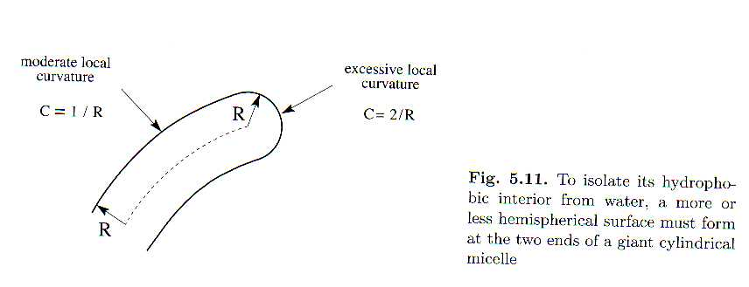
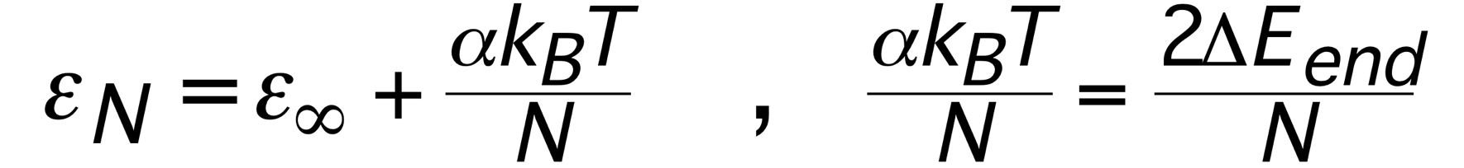
Cylindrical micelles
Spheres formed when:
1/3<v/l_{c}a₀ ≤ 1/2
Size of micelles finite but
ε_{N} has a no minimum -
energy of a molecule in the
cylinder is independent of
the size -> only 2∆E_{end}
-> forming larger micelles leads to energy gain, but a loss in entropy

Slide 43
Bi-layers

Slide 44
Bilayers
Bilayers formed when:
v/l_{c}a₀ > 1/2
∆E_{edge}(A) ∝ A^{1/2} (A - area of a layer)
dependent on the size of the bilayer
-> formation of infinite layers
Vesicles - closed surface by a bilayer
-> model for cell membranes
-> drug delivery systems
-> colloidal behaviour

Slide 45
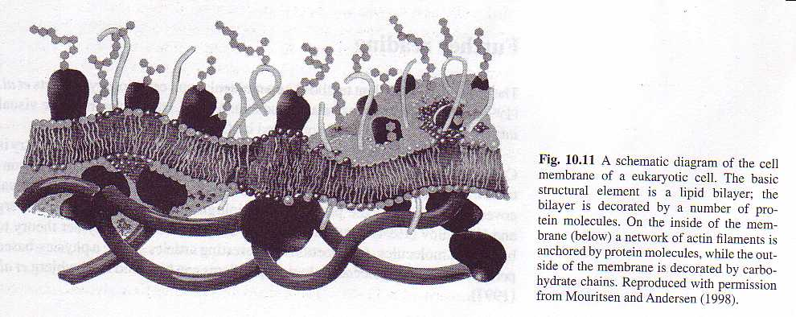
Bilayers
Cell membranes - phospholipid bilayers
Two tails give a large volume, v
v/l_{c}a₀ > 1/2

Slide 46
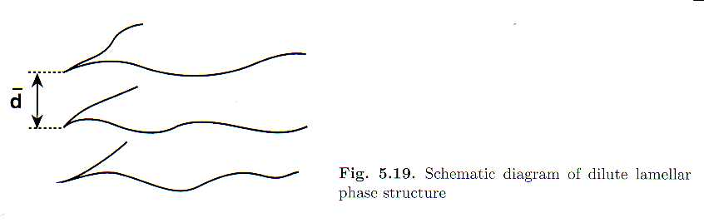
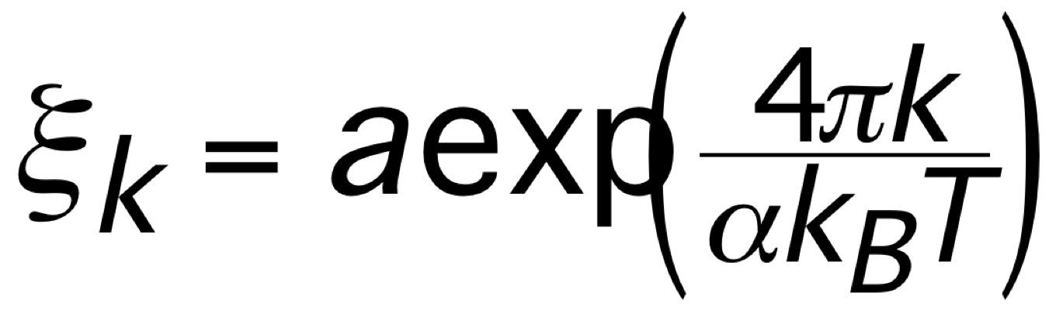
Bilayers
Bilayers are not flat - highly crumpled
Persistence length:
k - bending modulus of membrane
For r > ξ direction in membrane is lost
Lamellar phases can anyway be obtained
with very large d -> confinement between
two adjacent planes leads to loss in entropy

Slide 47
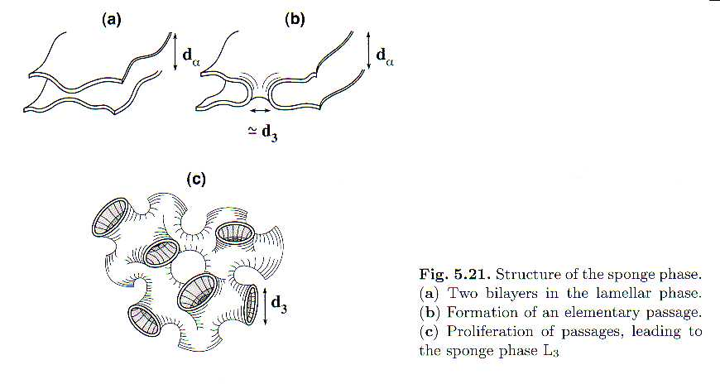
Bilayers
Lamellar phase can be distorted by fluctuations
forming complex geometries

Slide 48
Phase behaviour
Self assembled structures are rich in phases
-> response by changing size and shape and arrangement of micelles
-> dramatic change in properties

Slide 49
Phase behaviour
Self assembled structures are rich in phases
-> response by changing size and shape and arrangement of micelles
-> dramatic change in properties

Slide 50
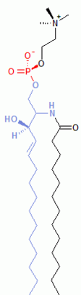
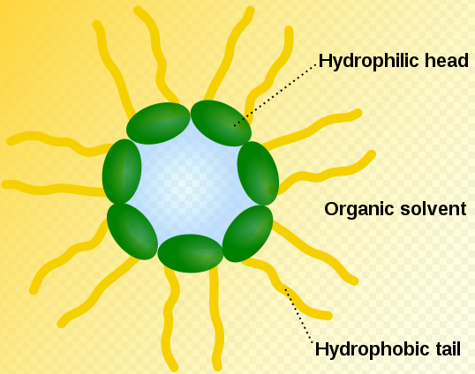
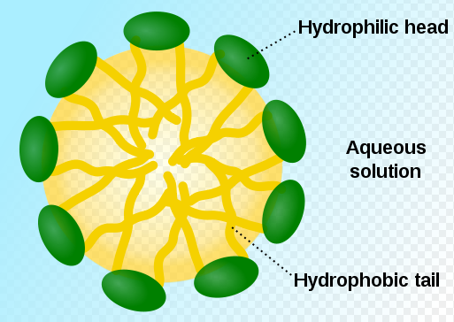
Micelles and Inverse Micelles
Surfactant: Hydrophilic Head Example: Phospholipid
+ Hydrophobic Tail
Micelle: Inverse Micelle:
Heads outside, Water outside Heads inside, Water inside

Slide 51
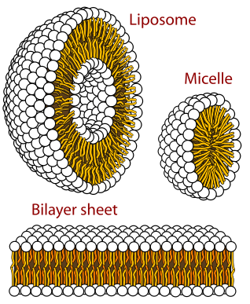
Bilayer Structures
, Vesicle
Part of a Cell Wall

Slide 52
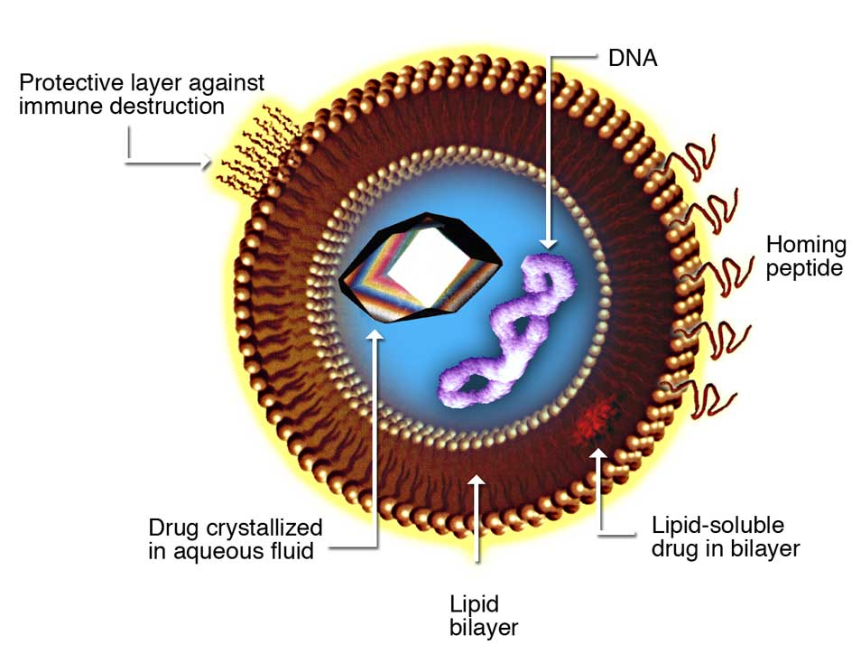
Drug Delivery via Liposomes

Slide 53
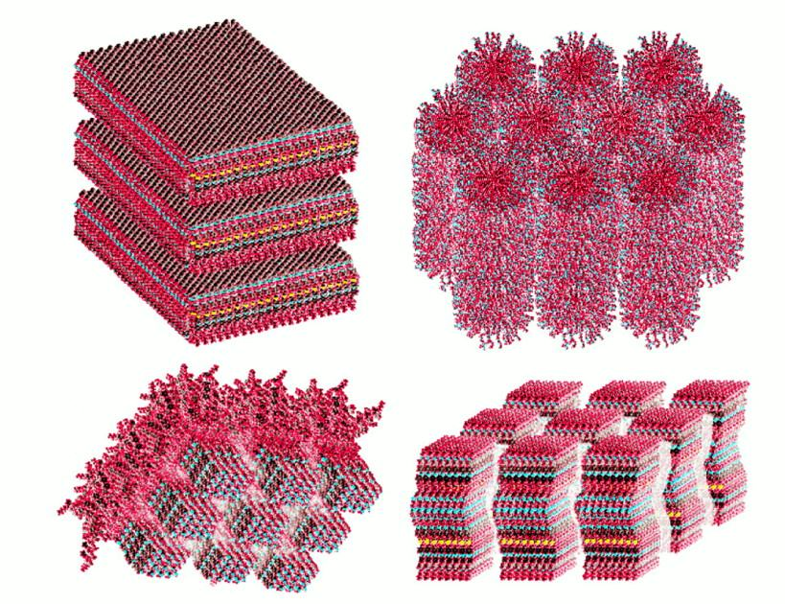
Supramolecular Assemblies

Slide 54
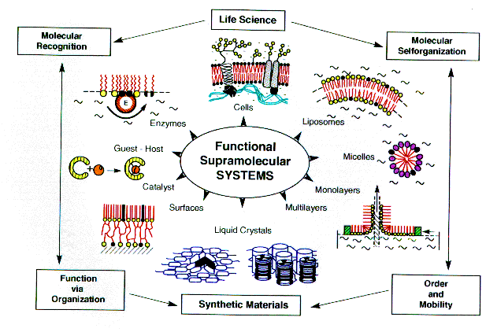
Notes:
This overview figure demonstrates the large variety of ways to mimic life in artificial nanostructures. It is taken from a highly popular study of the National Academy of Sciences which quickly went out of print. A 2008 follow-up study can be found at http://sites.nationalacademies.org/bpa/BPA_048192 .

Slide 55
Competitions on Self-Assembly

Slide 56
Competitions in Self-Assembly
Molecules often segregate at an interface to LOWER the interfacial energy - leading to an ordering of the system.
This self-assembly is opposed by thermal motion that disrupts the ordering.
Self-assembly usually DECREASES the entropy, which is not favoured by thermodynamics.
But there are attractive and repulsive interactions between molecules that dominate.
If free energy decreases (ΔF < 0), then the process is spontaneous.
ΔF = ΔU - TΔS
Internal Energy (U) decrease is favourable
Entropy (S) increase is favourable

Slide 57
Importance of Interfaces
Free energy change: dF = ΓdA
An increase in area raises the system’s free energy, which is not thermodynamically favourable.
So, sometimes interfacial tension opposes and destroys self-assembly.
An example is coalescence in emulsions.

Slide 58
Coalescence in Emulsions
Liquid droplet volume before and after coalescence:
r
R
Surface area of N particles: 4 N π r²
Surface area of droplet made from coalesced droplets: 4 π R²
Change in area, ΔA = - 4πr²(N-N^{2/3})
In 1 L of emulsion (50% dispersed phase), with a droplet diameter of 200 nm, N is ~ 10¹⁷ particles. Then ΔA = -1.3 x 10⁴ m²
With Γ = 3 x 10⁻² J m⁻², ΔF =ΓΔA = - 390 J.

Slide 59
Hydrophilically-driven self-assembly of particles
I. Karakurt et al., Langmuir 22 (2006) 2415

Slide 60
Synthesis of Mesoporous Materials

Slide 61
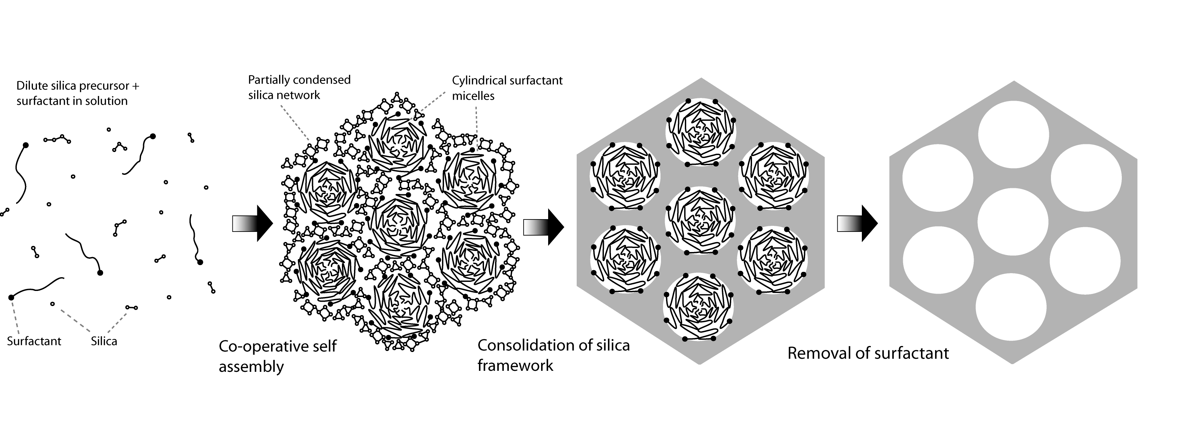
How do we use micelles to form mesoporous metal oxides?
Courtesy of Brian Eggiman

Slide 62
Self-assembled Block Copolymer Nanostructures
Block copolymers are amphiphilic molecules containing distinctively different polymer segments (blocks):
polystyrene (H (C₆H₅ – CH₂ – CH) - ) + poly isoprene (-CH₂ – H₃ (CH=CH₂)C - ) block
polystyrene and poly butadiene (- CH-CH=CH-CH) - ) block copolymer
(-CH₂-CH₂-) polyethylene and poly propylene (-(CH₂-CH₃CH)-) block copolymer
polyUrethane (-(CH₂-CH₂-O₂C-NH-C₆H₁₀CH₂-C₆H₁₀-NH-OC)-)+polyUrethane block copolymer
Different blocks in a single polymer chain are covalentely bonded.
The phase separation occurs on the nanometer scale, as determined by the dimension of the blocks.
Factors: monomer type, composition and molecular size, and molecular configuration.

Slide 63

2.5 Self-assembled Block Copolymer Nanostructures

Slide 64
2.5 Self-assembled Block Copolymer Nanostructures
Flory-Huggins segment-segment interaction parameter X:
phase separation is favored
E: Interaction Energy
f = volume fraction
f_{A} = f_{B} → straight cylinder → lamellar phase
f_{A} > f_{B} → cone structure → B phase dispersed in A phase as spherical micelles
f_{B} > f_{A} → cone structure → A phase dispersed in B phase as spherical micelles

Slide 65
2.6Co-Assembly of Liquid Structures and Inorganic Materials
Self-assembled liquid crystals from surfactants act as a template to support the growth of ceramic materials. These ordered structures are cross-linked together through the condensation of the aluminosilicate ions. Subsequently, the surfactant molecules can be removed by thermal or chemical treatment without collapsing the ordered structure (2-50 nm tunable).
Self-assembled periodic structures can be further used as a structural frame work to develop new materials:
by incorporating functional molecules and active sites into the porous channels (e.g. nanoporous silica)
by using the periodic nanoporous structures as a template (e.g. for carbon or metals)
by physically confining a new material in the organized nanostructures.

Slide 66

Co-Assembly of Liquid Structures and Inorganic Materials
Interactions between cationic surfactants and Anionic Silicates
Mesoporous materials: mixing aluminosilicate precursors (e.g. sodium aluminate, tetramethyl ammonium silicate, and silica) in a surfactant solution (e.g. ≥ 1 wt% cetyltrimethyl ammonium bromide (CTAB))
Inorganic ions play an important role in the self assembly process

Slide 67
Materials with controlled structure obtained through self-assembly
Micelles are removed to leave ~ 10 nm spherical holes. Structure has low refractive index. Can be used as a membrane.
Micelles are packed together
SiO₂ (silica) is grown around the micelles
P. Ball, Nanotechnology (2002) 13, R15-R28

Slide 68
Langmuir-Blodgett Films
Definition of LB films
History and development
Construction with LB films
Building simple LB SAMs
Nano applications of LB films
Surface derivatized nanoparticles
Functionalized coatings in LB films

Slide 69
Langmuir-Blodgett Films
A Langmuir-Blodgett film contains of one or more monolayers of an organic material, deposited from the surface of a liquid onto a solid by immersing (or emersing) the solid substrate into (or from) the liquid. A monolayer is added with each immersion or emersion step, thus films with very accurate thickness can be formed. Langmuir Blodgett films are named after Irving Langmuir and Katherine Blodgett, who invented this technique. An alternative technique of creating single monolayers on surfaces is that of self-assembled monolayers. Retrieved from "http://en.wikipedia.org/wiki/Langmuir-Blodgett_film"

Slide 70


Langmuir-Blodgett Films
http://www.bio21.bas.bg/ibf/PhysChem_dept.html
http://www.ksvltd.com/pix/keywords_html_m4b17b42d.jpg
Deposition of Langmuir-Blodgett molecular assemblies of lipids on solid substrates.

Slide 71
Self Assembly
Self-assembly is the fundamental principle which generates structural organization on all scales from molecules to galaxies. It is defined as reversible processes in which pre-existing parts or disordered components of a preexisting system form structures of patterns. Self-assembly can be classified as either static or dynamic.
http://en.wikipedia.org/wiki/Self-assembly

Slide 72
Molecular Self-Assembly
Molecular self-assembly is the assembly of molecules without guidance or management from an outside source. There are two types of self-assembly, intramolecular self-assembly and intermolecular self-assembly, although in some books and articles the term self-assembly refers only to intermolecular self-assembly. Intramolecular self-assembling molecules are often complex polymers with the ability to assemble from the random coil conformation into a well-defined stable structure (secondary and tertiary structure). An example of intramolecular self-assembly is protein folding. Intermolecular self-assembly is the ability of molecules to form supramolecular assemblies (quarternary structure). A simple example is the formation of a micelle by surfactant molecules in solution.
http://en.wikipedia.org/wiki/Self-assembly

Slide 73
Self Assembled Monolayers
SAMs – Self Assembled Monolayers
Alkane Thiol complexes on gold
C10 or longer, functionalized end groups
Can build multilayer / complex structures
Used for creating biosensors
Link bioactive molecules into a scaffold
The first cells on earth formed from SAMs

Slide 74


The Self-Assembly Process
A schematic of SAM (n-alkanethiol CH₃(CH₂)_{n}SH molecules) formation on a Au(111) sample.
The self-assembly process. An n-alkane thiol is added to an ethanol solution (0.001 M). A gold (111) surface is immersed in the solution and the self-assembled structure rapidly evolves. A properly assembled monolayer on gold (111) typically exhibits a lattice.

Slide 75

SAM Technology Platform
SAM reagents are used for electrochemical, optical and other detection systems. Self-Assembled Monolayers (SAMs) are unidirectional layers formed on a solid surface by spontaneous organization of molecules.
Using functionally derivatized C10 monolayer, surfaces can be prepared with active chemistry for binding analytes.
http://www.dojindo.com/sam/SAM.html

Slide 76
Surface Contamination
All surfaces become contaminated!
It is a form of ‘passivation’
Oxidation of metals
Adventitious hydrocarbons
Chemisorption of ions
It can happen very rapidly
And be very difficult to remove

Slide 77
Surface Treatments
Control friction, lubrication, and wear
Improve corrosion resistance (passivation)
Change physical property, e.g., conductivity, resistivity, and reflection
Alter dimension (flatten, smooth, etc.)
Vary appearance, e.g., color and roughness
Reduce cost (replace bulk material)

Slide 78

Surface Treatment of NiTi
Biomedical Devices and Biomedical Implants – SJSU Guna Selvaduray

Slide 79

Surface Treatment of NiTi
XPS spectra of the Ni(2p) and Ti(2p) signals from Nitinol undergoing surface treatments show removal of surface Ni from electropolish, and oxidation of Ni from chemical and plasma etch. Mechanical etch enhances surface Ni.
Biomedical Devices and Biomedical Implants – SJSU Guna Selvaduray

Slide 80
Surfaces in Nature
Cell membranes
Self-assembled phospholipid bilayers
Proteins add functionality to the membrane
Skin (ectoderm)
Lungs
Exchange of O₂, CO₂, and water vapor
Cell surface recognition (m-proteins)
Major histocompatibility complex

Slide 81



Molecular Self Assembly
3D diagram of a lipid bilayer membrane - water molecules not represented for clarity
http://www.shu.ac.uk/schools/research/mri/model/micelles/micelles.htm
Different lipid model
top : multi-particles lipid molecule
bottom: single-particle lipid molecule

Slide 82



Cell Membranes
http://faculty.clintoncc.suny.edu/faculty/Michael.Gregory/default.htm

Slide 83

Physical chemistry of solid surfaces

Slide 84

Surface
Nanostructures and nanomaterials possess a large fraction of surface atoms per unit volume.
For a cube of iron of 1 cm³ the % of surface atoms would be only 10⁻⁵%.
For a cube of iron of 1000 nm³ the surface atoms would increase to 10%.
This explain why changes in the size range of nanometers are expected to lead to great changes in the physical and chemical properties of the materials.

Slide 85

The total surface energy increases with the overall surface area
For 1gr of NaCl
When the particles change from centimeter size to nanometer size, the surface area and the surface energy increases seven orders of magnitude

Slide 86
Important
All nanostructured materials possess a huge surface energy.
They are thermodynamically unstable or metastable.
It is necessary to overcome the surface energy, and to prevent the nanostructures or nanomaterials from growth in size, driven by the reduction of overall surface energy.

Slide 87
Surface energy
Origin
Atoms or molecules on a solid surface possess fewer nearest neighbors or coordination numbers, thus have unsatisfied bonds exposed to the surface.
The lattice constants of the entire solid particles show an appreciable reduction.

Slide 88
When there is an appreciable surface relaxation such as the surface atoms moving inwardly, or there is a surface restructuration, surface energy will be lower than that estimated by this equation.
Definition
It is the energy required to create a unit area of “new” surface
number of broken bonds
Number of atoms/unit area
when brake into two pieces
surface area
half of the bond strength

Slide 89



Slide 90

There is a strong tendency to minimize the total surface energy
Surface relaxation. The surface atoms or ions shift inwardly which occur more readily in liquid phase than in solid surface due to rigid structure in solids. This would result in a reduction of the surface energy.

Slide 91

Mechanisms to minimize the total surface energy
Surface restructuring through combining surface dangling bonds into strained new chemical bonds.

Slide 92
Surface energy of (100) faces in diamond and silicon crystals before restructuring is higher than both (111) and (110) faces.
However, restructured (100) faces have the lowest surface energy among three low indices faces, and such surface restructuring can have a significant impact on the crystal growth.

Slide 93

Mechanisms to minimize the total surface energy
Through chemical or physical adsorption of terminal chemical species onto the surface by forming chemical bonds or weak attraction forces such as electrostatic or van der Waals forces

Slide 94
Mechanisms to minimize the total surface energy
Composition segregation or enrichment of impurity on the surface through solid-state diffusion.
In nanostructures and nanomaterials phase segregation may play a significant role in the reduction of surface energy, considering the great impact of surface energy and the short diffusion distance.

Slide 95
At the individual nanostructure level, there are two approaches to the reduction of the total surface energy
Reduce the overall surface.
For liquid and amorphous solids, spherical shape
Water on a hydrophobic surface
Hot glass
For a crystalline solid different crystals facets possess different surface energy.
A crystalline particle normally forms facets
There is a minimal surface energy when a group of surfaces is combined in a certain pattern.

Slide 96

Examples of single crystals with thermodynamic equilibrium shape. (Top-left) Sodium chloride,(top-right) silver, (bottom left) silver, and (bottom-right)gold.

Slide 97
Morphology
Kinetic factors, which are dependent on the processing or crystal growth conditions.
Non equilibrium conditions.
Below certain temperature the crystal is faceted.
Most nanoparticles grown by solution methods at elevated temperatures are spherical in shape and do not form any facets.

Slide 98
At the overall system level, mechanisms for reduction of overall surface energy include:
Combining individual nanostructures together to reduce the surface
Sintering, in which individual structures merge together, 0.7Tm. (must be avoided)
Ostwald ripening, in which relatively large structures grow at the expense of smaller ones.
Agglomeration of individual nanostructures without altering the individual nanostructures (should be prevented)

Slide 99

Sintering & Ostwald ripening
Fig 2.9

Slide 100
Measuring Surfaces
AFM – Atomic Force Microscopy (1)
SEM – Scanning Electron Microscopy (2)
XPS (ESCA) – X-Ray Photoelectron Spectroscopy (3)
AES – Auger Electron Spectroscopy (3)
SSIMS – Static Secondary Ion Mass Spectroscopy (4)
Laser interferometry/Profilometry (5)

Slide 101
Summary
Surfaces are discontinuities
Surface area creates energy
Dangling bonds lead to passivation
Interfaces are critical to ‘bonding’
Surfaces can be modified / derivatized
Surfaces are critical to life
All important things happen at a surface!

